Slide 1

Date 30 Julai 2018
Time 8.30 pagi
Venue Pejabat HQ
PUSH START BUTTON

Slide 2



INTRODUCTION
  A smart key is an electronic access and authorization system that is available either as standard equipment or as an option in several car models.
  It was first developed by Siemens in 1995 and introduced by Mercedes-Benz under the name "Key-less Go" in 1998 on the W220 S-Class, after the design patent was filed by Daimler-Benz on May 17, 1997.
  It can simplifies turning your car on and off using a key fob
  In cars that have keyless, push-button ignition, an electronic key fob is recognized by the car to authorize driving and the use of power accessories
  The keyless ignition system allows you to keep the key fob in your pocket when you unlock and start the vehicle.
  That fob can conveniently remain in the driver's pocket or purse, as the ignition switch itself is just a button on the dash.

Slide 3

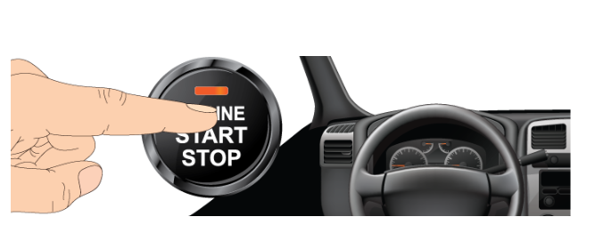
HOW IT WORKS
  What it does ?
- This feature simplifies turning the car on and off. It’s really as simple as pressing and holding a button.

Slide 4
WHAT YOU NEED TO DO
After you get into the car, you should apply the brake then press and hold the engine start/stop button until your engine turns on.
To turn off your car, make sure your car is in the parked gear, then press the engine start/stop button until the engine shuts off completely.
You may also need to press the parking brake while you push the start button.

Slide 5
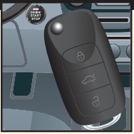
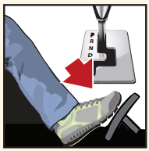
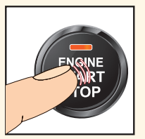
Steps how to use push start button.
Make sure the key fob is inside the vehicle.
Step on and hold the brake. Make sure gear is at Park (P)
Push and hold the button until the engine starts

Slide 6
ADVANTAGE AND DISADVANTAGE OF PUSH START BUTTON

Slide 7
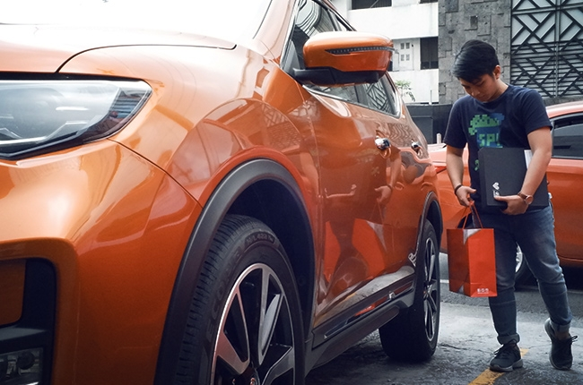
Hands-Free Operation
When your hands are full from grocery shopping or from carrying piles of office files, and nothing beats the ability to just tap a button with any part of your body to unlock the car .
As long as you’re in range of the vehicle, the doors and trunk should be ready to access.
Some cars, even allow you to open the just by using the smart key.

Slide 8
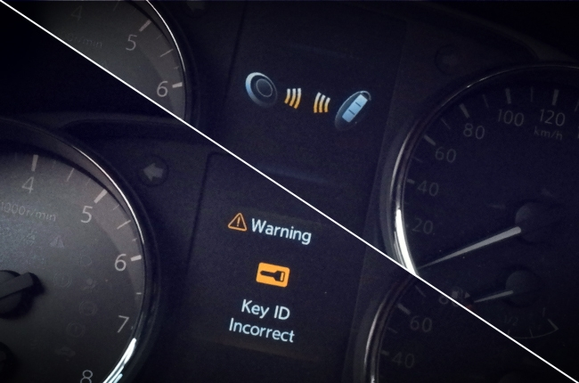
2) More Layers of Security
You feel safer with the knowledge that a unique code is required to start your car .
The transponder needs to be authorized by a code that the vehicle’s computer searches for.
Only once the code is found will the vehicle start or unlock.
Some systems also use computer-encrypted microchips. These features allow for even more layers of safety.
The technology will detect if the key is inside the car – which makes it almost impossible to lock your keys inside your car

Slide 9
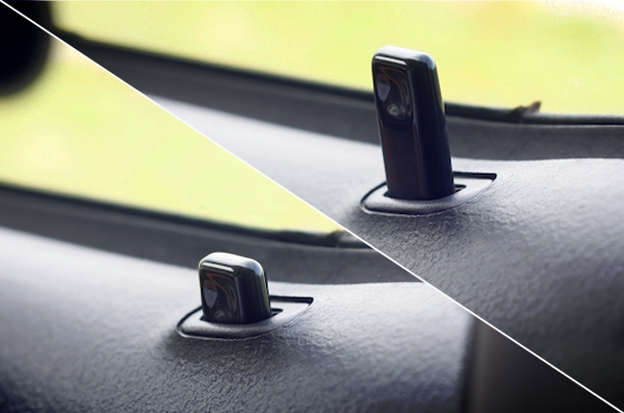
3) Automatic Locking System.
These only happens for several cars only.
There were times when you’ve had to walk back to the parking lot just because you didn’t remember if you locked your vehicle.
In some vehicles, there’s a system in which, after parking the vehicle, one simply has to walk away.
After a distance, the car will automatically lock itself, as if you were pressing the lock button on the door or key fob.
It essentially eliminates the possibility of forgetting to lock one’s vehicle.

Slide 10

DISADVANTAGES
1) The Cost
The price of a keyless fob and push-button ignition is included in the price of the vehicle.
But, as with any electronic component, it wears over time until it comes to a point that you have to replace the entire key fob or repair the whole system.
That can be a pricey purchase just to be able to start your car again.

Slide 11
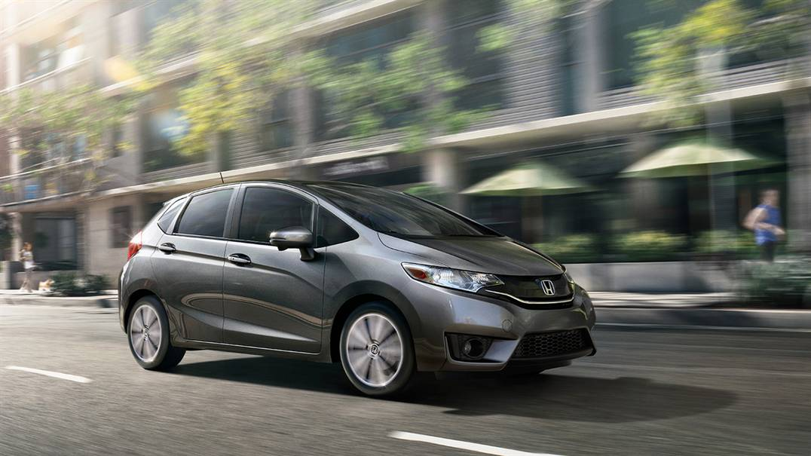
2) Your Car is still Running
You can count on manufacturers to place all the warning lights and chimes when you leave your car with the engine on.
Some cars run so quietly, that, in a crowded or busy street or parking lot, there’s a possibility of you leaving the car running as you walk hurriedly to your errand.
Some cars will usually shut off as a safety feature, but if you’re brand or model doesn’t have it, in theory, your vehicle will keep running until it runs out of gas.

Slide 12

3) Thieves are Getting Smarter
The keyless systems make it difficult for cars to be stolen.
But, with computerized controls, hackers will be developing new ways to try to steal your car.
Key programming tools and chips can be found online, and may only be purchased by authorized dealers and mechanics.
If these tools end up in the wrong hands, they could easily reprogram a blank key fob to your car’s transponder code, or even hack into the car’s electronic systems to operate the vehicle. Scary stuff.

Slide 13
Conclusion
As with most technology and advancements in the auto industry, you can find things to love and to not love about push-button starts.
But as they become industry standard, it’s important for every driver to learn how to use them properly.
Learn more about new technologies that are transforming and improving the styles of driving.

